Slide 1


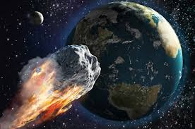
Project 3 Shooting for the Stars…
Group Members:
Kevin Ewing
Kent Hazen
Kerwin Hsu
Fred Tinio

Slide 2
What is a Meteorite
Meteorite:
Is a solid piece of debris from an object, such as a comet, asteroid, or meteoroid, that originates in outer space and survives passage through the atmosphere to reach the surface of a planet or moon. When the object enters the atmosphere, gases cause to heat up and radiate that energy, it then becomes a meteor and forms a fireball, also known as a shooting star or falling star.
Meteorite Classifications:
Traditional classification schemes are divided into three overall categories based on whether they are dominantly composed:
Rocky material (Stony meteorites)
Metallic material (Iron meteorites)
Mixture (Stony-iron meteorites)

Slide 3
Shooting for the stars…
Meteorites
Only a small fraction of this world’s population as ever seen a meteorite fall. The purpose of this project is to explore and visualize information about all know meteorite landings. Some specific information about the meteorite landings to show include the name of the meteorite, the meteorite’s ID, the mass, recclass, and the year the meteorite was found.
Data Sources
We used one primary data source to processes to cleanse and prep files in the following formats:
CSV files /.txt files / Spreadsheets
https://data.nasa.gov/ (.txt converted to csv)
Specific Requirements
We used several techniques to process, cleanse and prep the data files:
Planetary JS Library
MySQL Server
D3
Jupyter Notebook
Pandas
JSON
FLASK

Slide 4
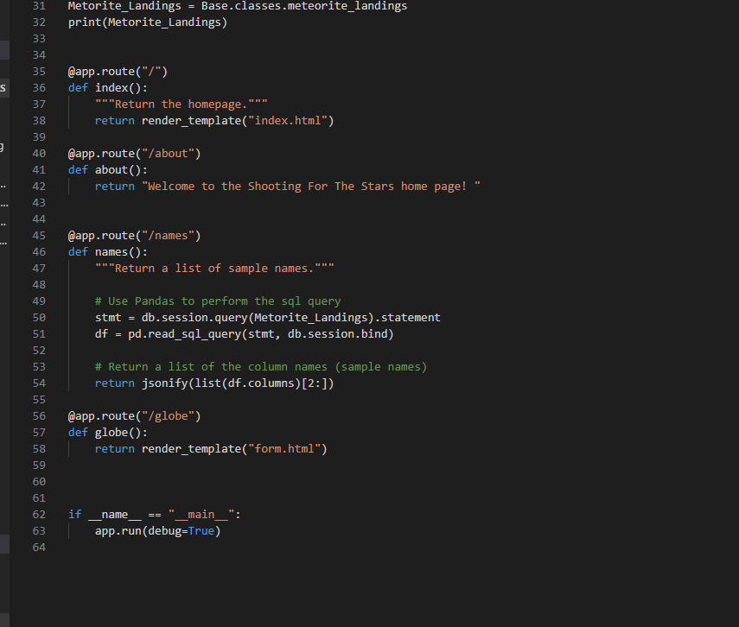
Flask/MySQL Alchemy

Slide 5
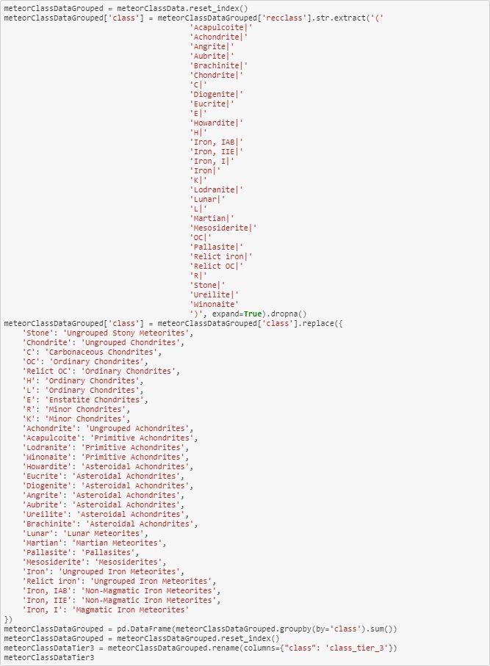
Meteor Classification Cleaning

Slide 6
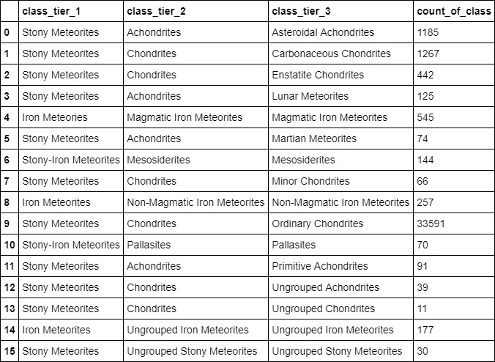
Meteor Classification Data

Slide 7
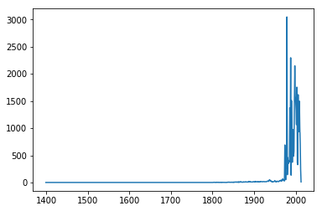
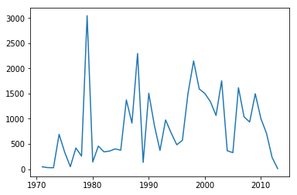
Data Visual Meteorite hits by year
Meteorite overall hits from Year 860 when records were first documented
Meteorite hits after 1970 where significant data was documented

Slide 8

Planetary JS Library

Slide 9
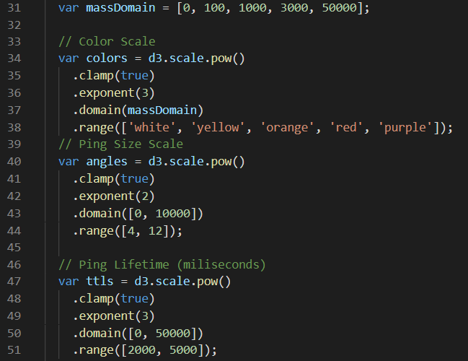
Planetary JS Library

Slide 10
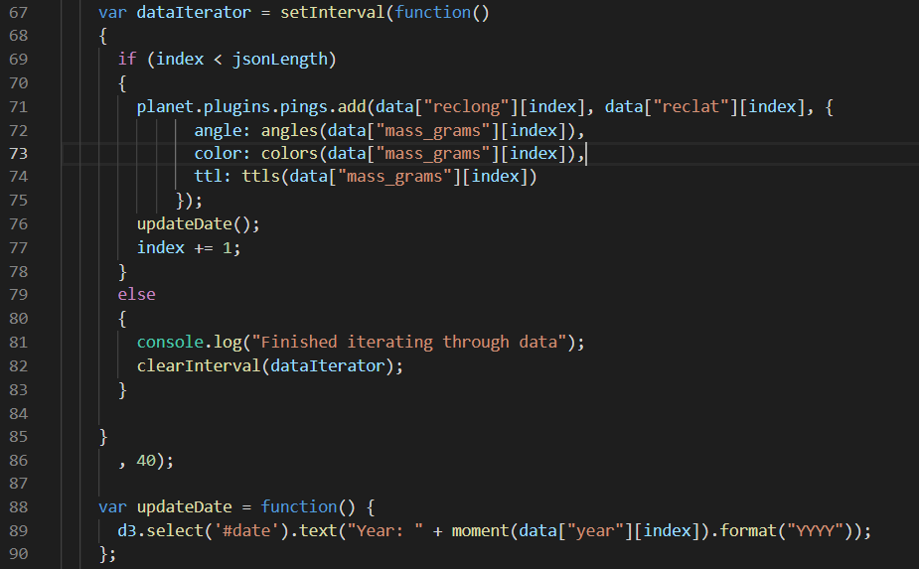
Planetary JS Library

Slide 11
Visual Impact Locations

Slide 12
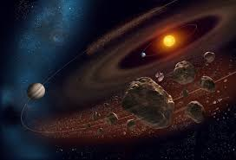
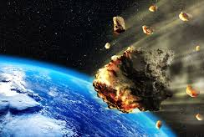
LIVE DEMO
Remember
Meteorites are cool…

Slide 13
Appendix

Slide 14
XXX

